Slide 1


Content Creation Module and Discussion Forum Indian Institute of Information Technology, Allahabad
Improving Access to Science and Technology Higher Education in Resource-Poor Institutions through an Open Platform for Technology Enabled Active Learning Environment / TEAL2.O
Ref. no. 610186-EPP-1-2019-LK -EPPKA2-CBHE-JP
The European Commission's support for the production of this publication does not constitute an endorsement of the contents, which reflect the views only of the authors, and the Commission cannot be held responsible for any use which may be made of the information contained therein.

Slide 2

Group Members
MRIDUL MITTAL IIT2019127
PARAS AGRAWAL IIT2019145
KSHITIJ KUMAR IIT2019146
PIYUSH GURJAR IIT2019148
AMIT JAIN IIT2019150

Slide 3
TEAL 2.0 and its Objectives
Technology Enabled Active Learning 2.0 (TEAL 2.0) is an online course platform.
It is similar to Moodle or Canvas but TEAL 2.0 provides customizability and collaborative development.
Its objectives are:
Enabled Active Learning platform.
Content Development

Slide 4
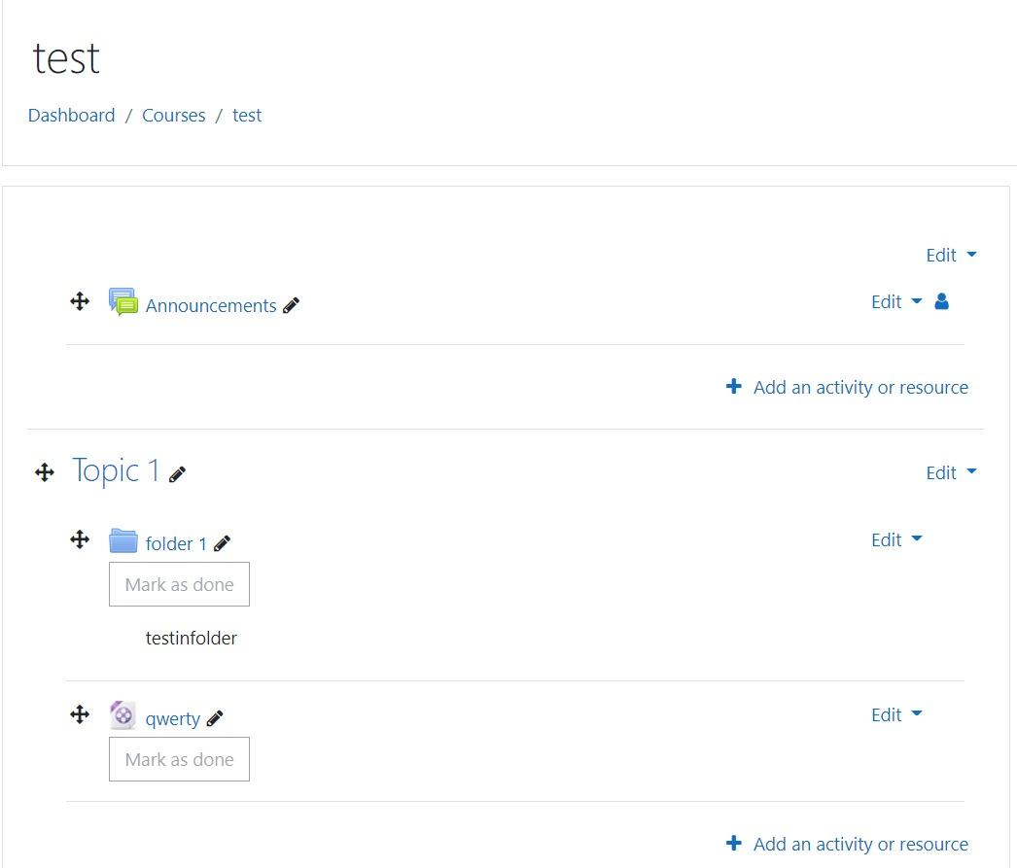
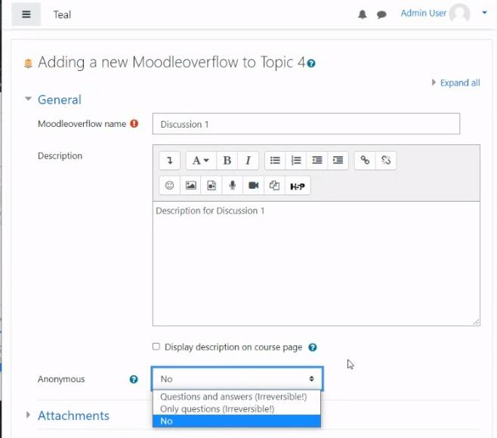
Our Module Objective
Content Creation Module
Discussion forum using MOODLE

Slide 5
What have we worked on?
Installed a basic version of moodle to work on.
Several versions of plugins
Open Source Functional plugin
Design some UI pages to add basic functionality to the software.

Slide 6
What have we worked on?
Added extra features which are not readily available on moodle.
For Content-Creation:
Added pdf reader feature
Added download feature
For Discussion Forum:
Added Rating and Reputation feature

Slide 7
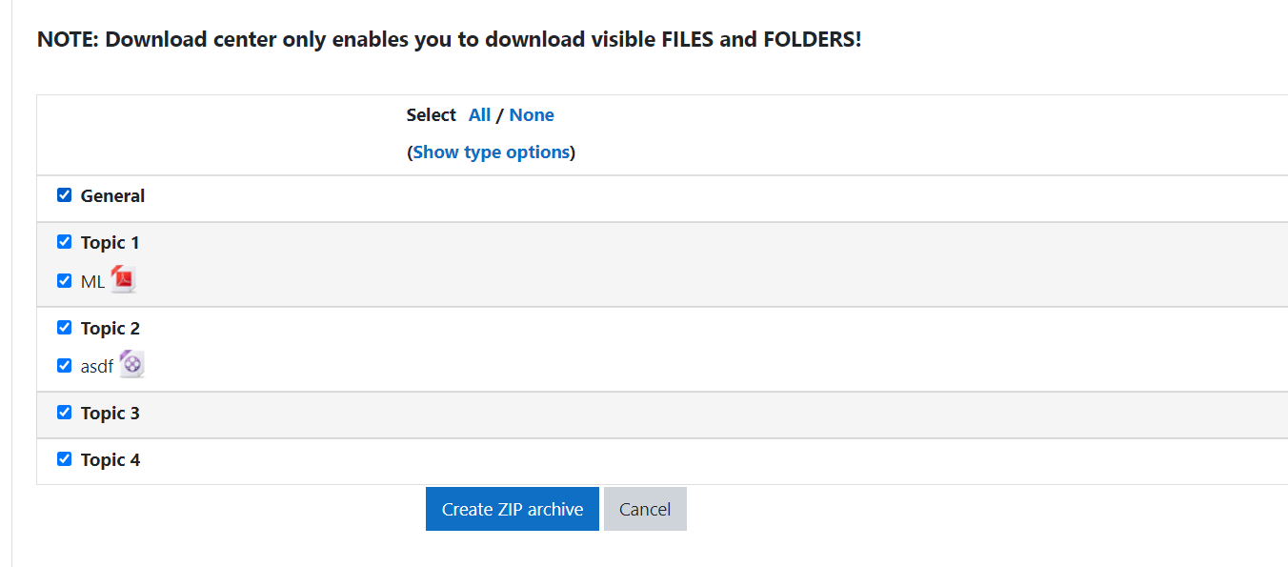
Extra-Features-Content Creation
Download course content directly.

Slide 8
Features-Content Creation
Managing Course Content
Add new content
Video Lectures,Text files and audio files
Modify content
Delete content
Can upload content from a different existing course.
Activity completion

Slide 9
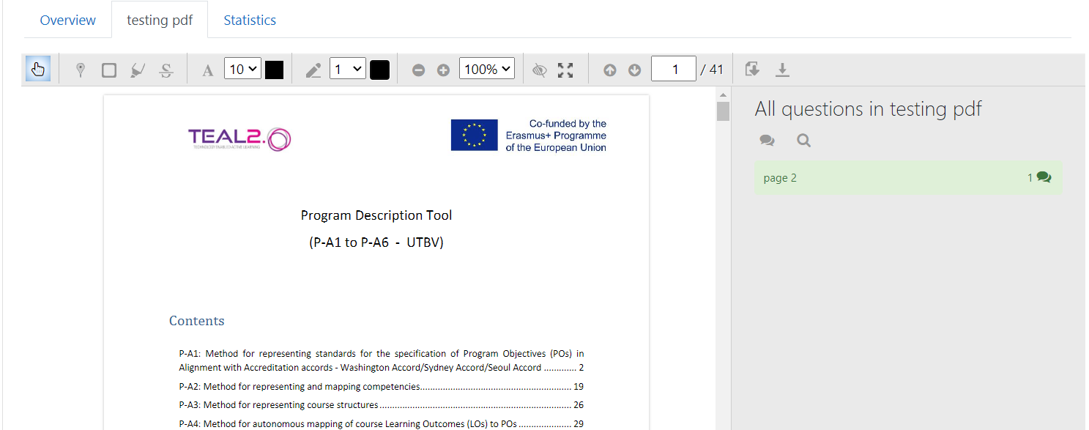
Extra-Features-Content Creation
The extra feature which we have added is: PDF- Reader.

Slide 10
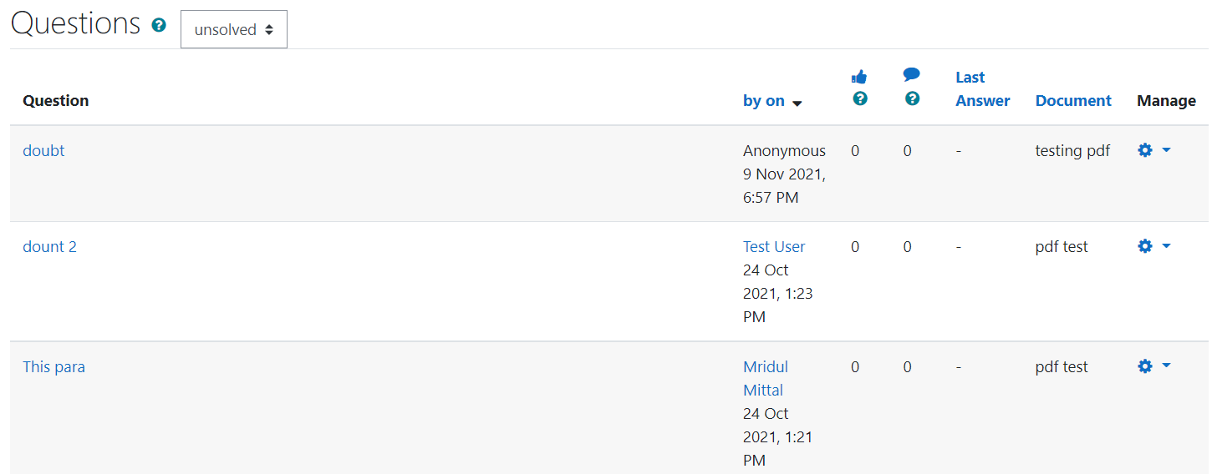
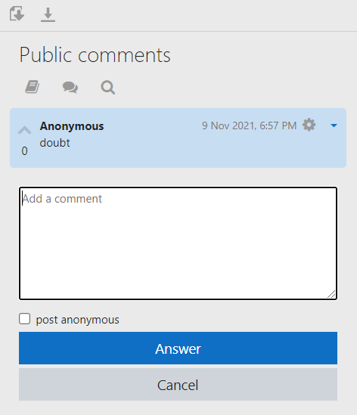
Extra-Features-Content Creation
Creating a doubt session while reviewing a pdf.

Slide 11
Features - Discussion Forum
Split Discussion
Private reply
Multimedia Attachment
Different types of forums already exist :-
Standard forum for general use
Each person posts one discussion
Q and A forum
Standard forum displayed in a blog like format
Standard forum for general use.

Slide 12
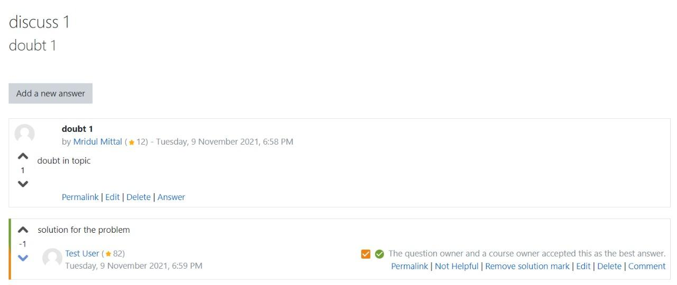
Extra-Features Discussion Forum
The extra feature which we have added is: Rating and Reputation feature using Downvote and upvote feature.

Slide 13
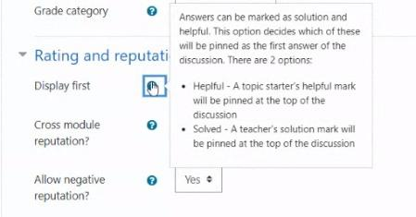
Extra-Features Discussion Forum
Mark as helpful or solved to the post and sub-posts.

Slide 14
Project Plans
C3 Presentation: Fully Functioning plugins with Content-Creation Module, Discussion Forum and initial targets.

Slide 15
Conclusion
We have successfully completed the target for C3 plans.

